Slide 1

Chess-Game-Playing-AI: Minimax vs. Alpha-β Pruning
AI Assignment 3 – Game Playing
Project Objective:
Demonstrate how AI algorithms can be used for Chess game playing.
Compare two search algorithms: Minimax and Alpha‑β Pruning.
Overview of Implementation:
Implemented using the python‑chess library.
Utilizes a simple, material-based evaluation function.
Presented by:
Aman Kumar (CS24M114)
Shashi Mani (CS24M116)

Slide 2
Environment Setup & Evaluation Function
Chess Environment
Library:
python-chess
Features:
Chessboard representation using FEN notation.
Automatic move generation.
Detection of terminal conditions (checkmate , stalemate).
Evaluation Function
Methodology:
A simple material count where each piece is assigned a value.
Assigned Values:
Pawn: 1 point
Knight/Bishop: 3 points each
Rook: 5 points
Queen: 9 points
King: 0 points (invaluable)
Purpose:
Score represents the advantage (positive for White, negative for Black).

Slide 3
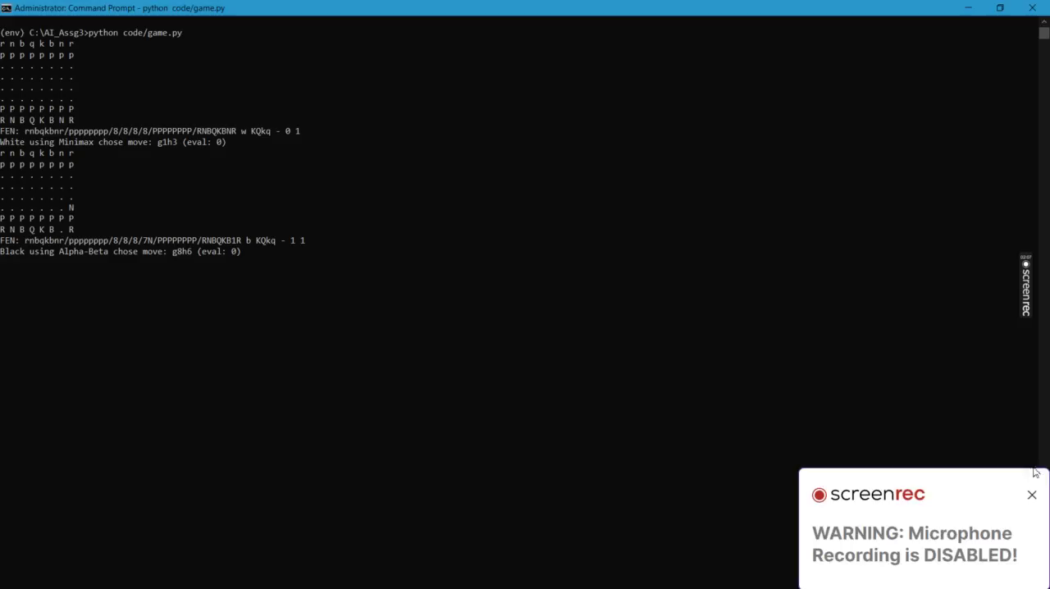
Algorithm Details & Live Demonstration
Algorithm Implementations:
Minimax (White):
Concept: Recursively explores game tree; selects moves that maximize the score.
Operation:
Maximizes the evaluation score.
Base condition: Depth limit reached or game over.
Pros:
Guaranteed optimal move if full search is possible.
Alpha‑β Pruning (Black):
Concept: An optimization on minimax that prunes branches that won’t affect the outcome.
Operation:
Uses two parameters, α and β, to limit the search.
Reduces computation by eliminating irrelevant moves.
Pros:
Faster than plain minimax; same optimal move with less computation.

Slide 4
Results & Performance Comparison
Simulation Results
Observation:
Early game moves have low evaluation differences.
As the game progresses, evaluation scores start diverging reflecting the material gain or loss
Result Summary
Alpha-β Pruning reduces computation time significantly by pruning unnecessary moves.
Performance Analysis
Performance Metrics:
Minimax:
Full search, but computationally expensive, especially at higher depths.
Alpha-β Pruning:
Efficiently prunes branches, reducing the number of nodes evaluated.

Slide 5
Conclusions & Future Directions
Conclusions:
Algorithm Efficiency:
Both algorithms yield optimal moves in theory.
Alpha‑β Pruning shows significant performance improvements over standard Minimax.
Evaluation Function:
A simple material-based evaluation function serves as a good starting point.
Limitations exist: Lack of positional considerations and advanced heuristics.
Future Work:
Evaluation Enhancements:
Incorporate positional aspects such as king safety, pawn structure, etc.
Algorithm Optimizations:
Implement iterative deepening and move ordering to further boost performance.
Extended Applications:
Apply similar techniques to other games (e.g., Slime Volleyball) or more advanced Chess scenarios.
User Interactivity:
Consider developing a GUI for real-time move analysis and visualization

